Slide 1
Spartans ADVANCE Launch
Welcome
Introductions
Meet the Team
NSF ADVANCE Program
UNCG Self-Study
UNCG ADVANCE

Slide 2
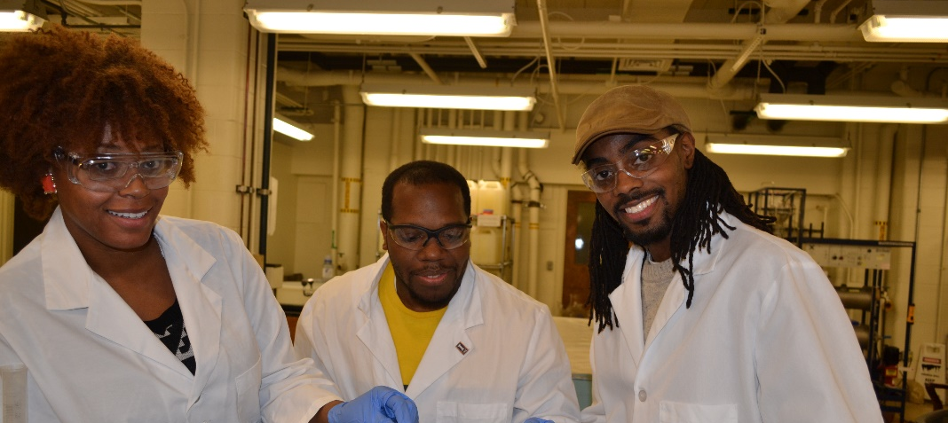
Organizational Change for Gender Equity in STEM Academic Professions
Aims for gender, racial, and ethnic equity in STEM faculty
Aims to enhance the systemic factors that support equity and inclusion
Aims to mitigate the systemic factors that create inequities in the academic profession and workplaces
ADVANCE

Slide 3
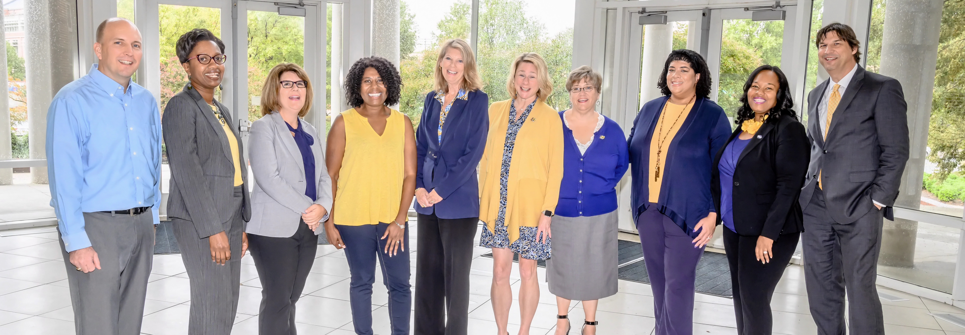
UNCG ADVANCE
$1 Million investment
3 years
Launch date October 29, 2019
PI Provost Dunn
Co-PIs: Boyce, Brown-Jeffy, Glenn, Mendez-Smith, Shelton
SPs: Haines, Littlefield, Reid, Turner, Voorhees
Goal: Institutional Transformation

Slide 4
UNC Greensboro Self-Study

Slide 5
Number of faculty by gender, compared across rank, and compared across STEM versus non-STEM departments, at UNCG

Slide 6
Research output metrics from the UNCG Office of Research for the past 6 years in STEM and non-STEM departments at UNCG.

Slide 7
Research output metrics from the UNCG Office of Research for the past 6 years in STEM and non-STEM departments at UNCG.

Slide 8
Qualitative Study of Work-Life Balance at UNCG

Slide 9
Findings: Strengths – Supportive policies
“I have been SO HAPPY with the provost's family leave policy changes over the last few years. She instituted 1-semester teaching leave for faculty which was life changing for me when I had a baby. I brag about this policy to everyone who interviews in my department.”

Slide 10
Findings: Challenges – Lack of Awareness of Policies
“We moved to Greensboro with an infant. My department really did not know how to handle this; I will accept responsibility and say that I also did not know how to handle this--I should have requested some sort of accommodation. I later learned that others had been able to defer starts; literally no one in my department talked to me about any options I might have had .”

Slide 11
Findings: Challenges – Ensuring Access
“Sometimes offering isn’t enough, but access should be easy and natural. Policies will be meaningless unless they are taken advantage of.”

Slide 12
Findings: Challenges – Unclear guidance for policies
“One odd thing, after I took maternity leave and still did an annual review. My chair didn’t know how to evaluate me. They acknowledged it, but the standard was still the same. Maybe there should be more guidance for those who review people who take leave… it means they were not working..”

Slide 13
Areas of Need and Proposed Actions
Spartans ADVANCE
NEED
1. Equity in numbers of Associate Professors and Professors in STEM departments
2. Equity in number of proposals submitted, grants awarded, and grant size in STEM departments
3. Awareness, standardization, and implementation of policies that promote career – life balance of STEM faculty
Committee Enhancements
Exit Interview Data
Research Networks
Faculty Mentoring
Proposal Review for Equity
Workload Policy Equity
Research Networks
Proposal/Resubmission Workshops
Promote Existing Career-Life Policies
Central Career-Life Website
Floating Research Technician
ACTIONS
Support a culture of care through Spartans ADVANCE Allies in Deans/Associate Deans of Research/Heads & Chairs
actions will be intersectional and promote equity, diversity, and inclusion across all disciplines
evaluation and assessment will happen through UNCG-OAERS

Slide 14
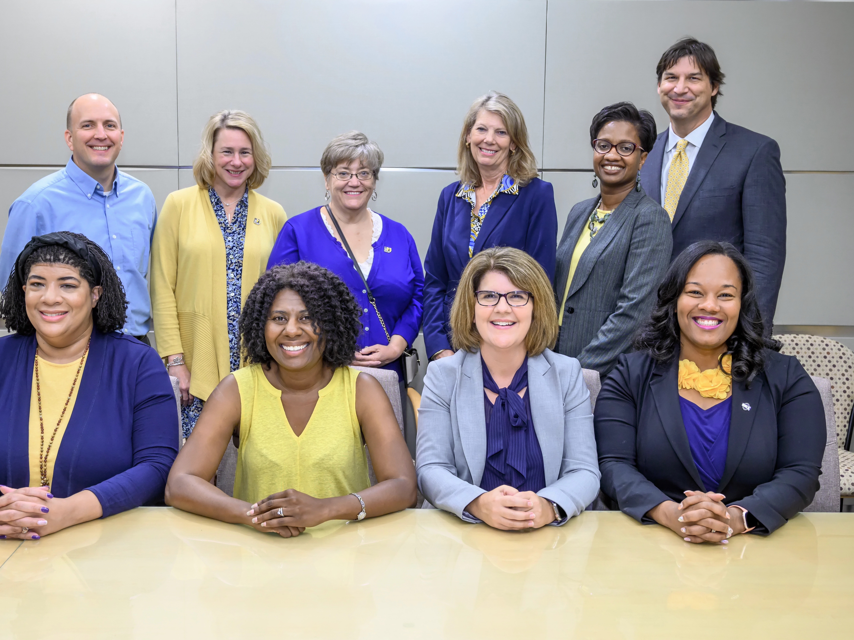
Thank you

